Slide 1
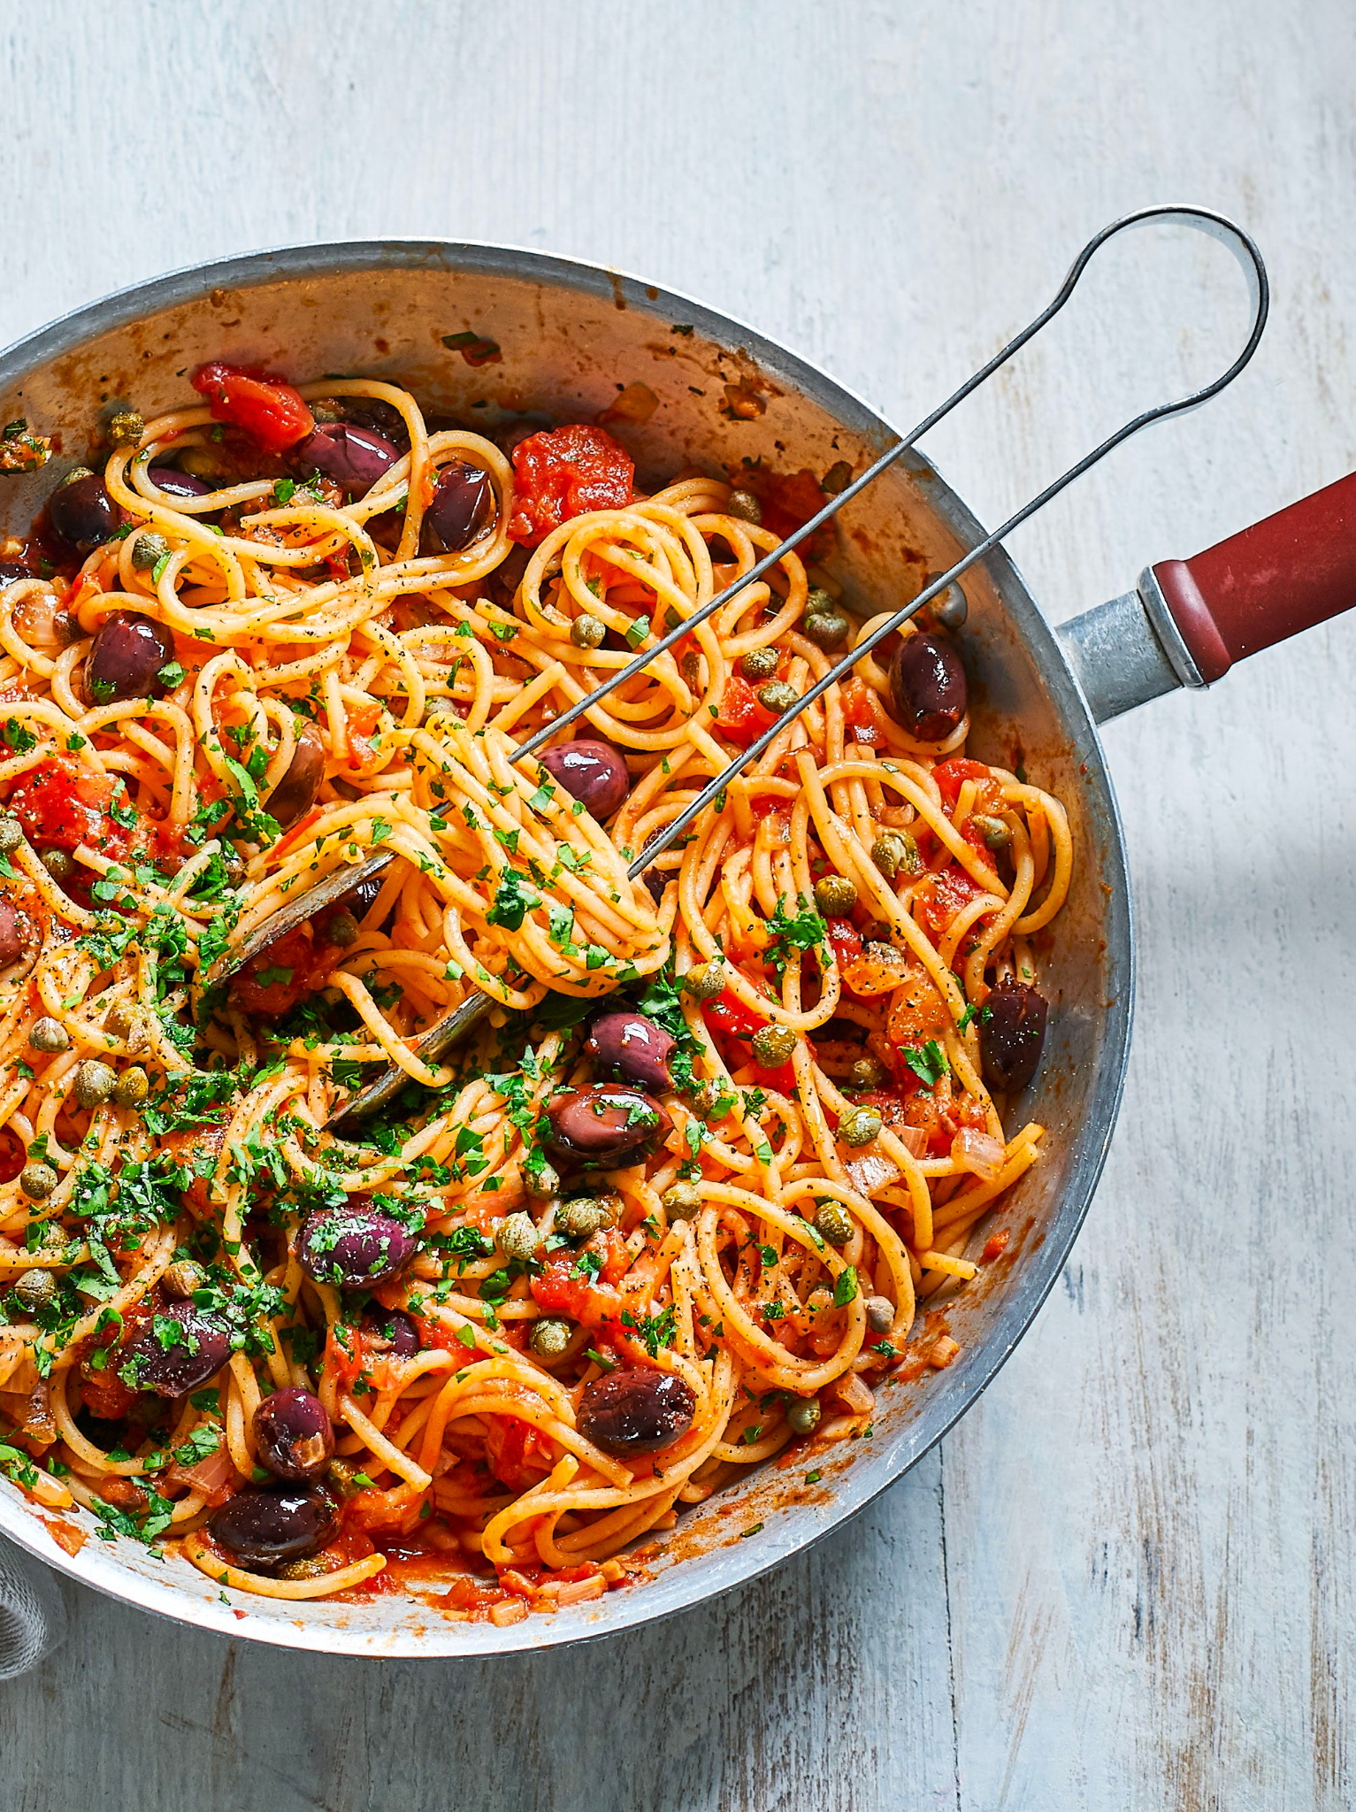
RecAPI
“If you have something to steam, roast or peel, we will guide you to your meal!”
By Hanqing, Carla, Danielle, Sakusan
Notes:
Hanqing

Slide 2
Agenda
Our Approach
What Does Our API Do?
Postman Request Demo
Our Code
Improvements & Development
Reflection & Conclusion
Notes:
Hanqing

Slide 3
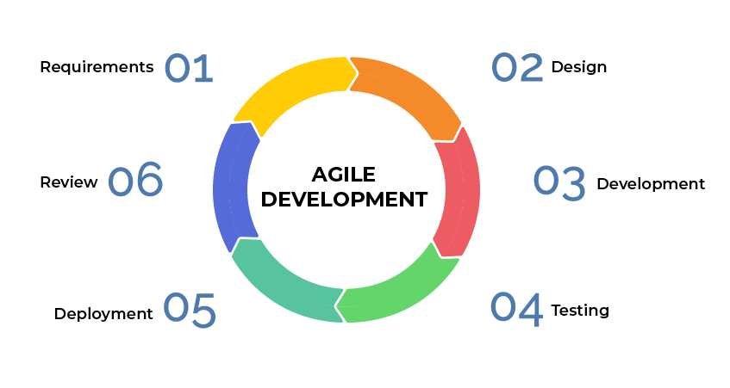
Our Approach
What the team did:
~ Continuous collaboration
~ Member progress updates
~ Sort MVP + Extensions
~ Regular code testing
Agile Methodology
How the team benefited:
~ Improved agility
~ Increased alignment
~ Reduced risk
~ Improved team spirit!
Notes:
Carla

Slide 4








Our Tools
- Draw.io - collaboration
- Project Management Tool: Trello board
- How we decided on the API
Collaboration
Project Management
Notes:
Carla

Slide 5
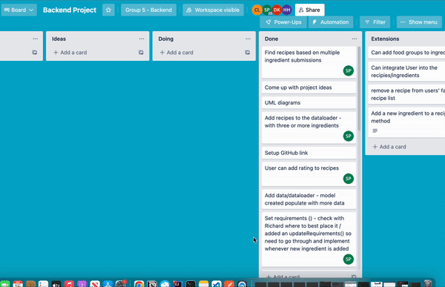
Project Management
- Draw.io - collaboration
- Project Management Tool: Trello board
- How we decided on the API
How the team used Trello:
~ Create Workspace + Invite Members
~ Add 6 board..
~ Add tasks
~ Assign Tasks
~ Move tasks once complete
~ Repeat from step 3 when needed
Notes:
Carla

Slide 6
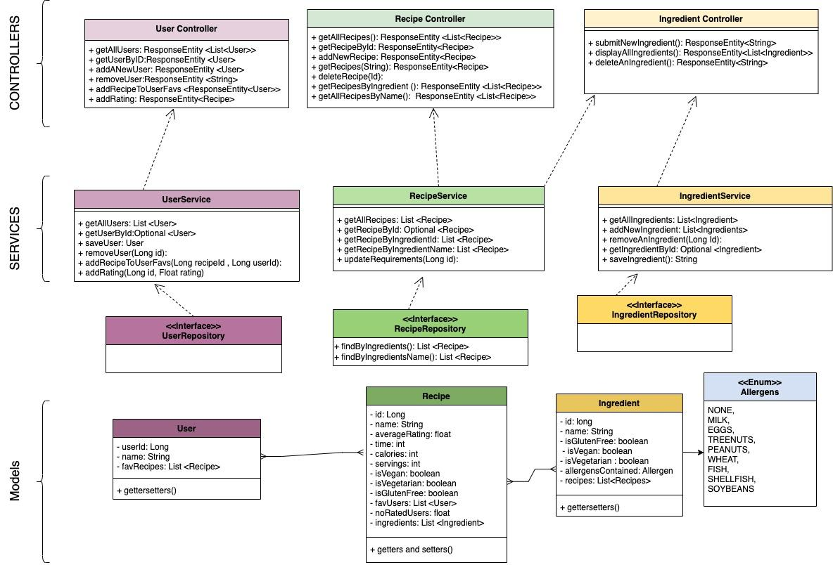
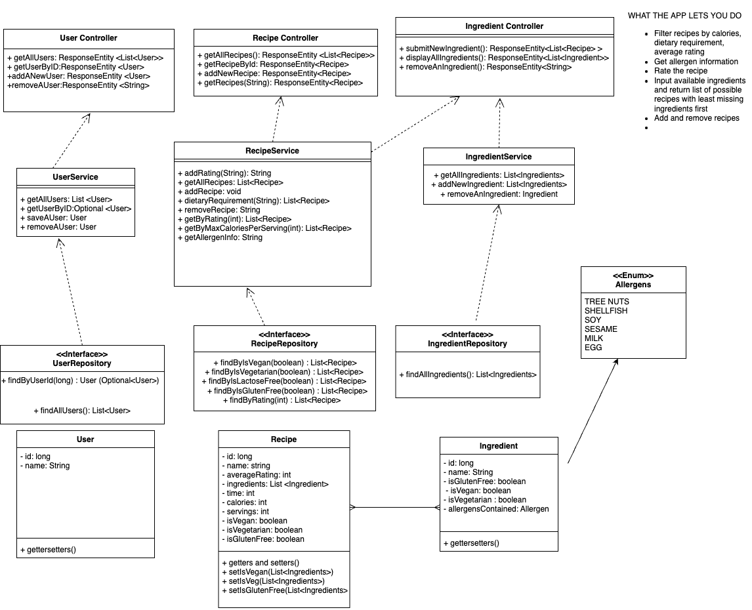
Unified Modeling Language (UML) Diagram
Initial UML
Revised UML
Notes:
Carla

Slide 7
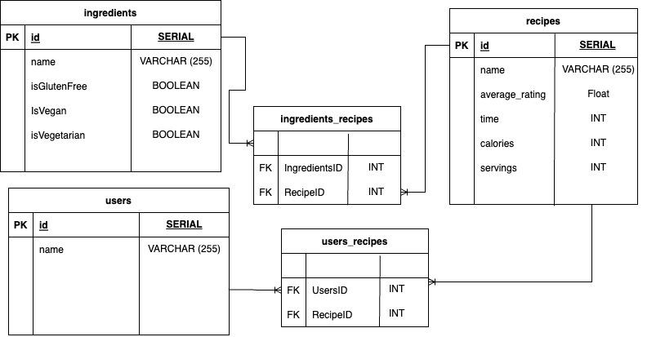
Entity Relationship (ERD) Diagram
Revised ERD
Notes:
Carla

Slide 8
What does our API do?
Our API is designed to helps users find recipes based on their available ingredients.
User Controller | Recipe Controller | Ingredient Controller
Create and delete profile Add recipes to their favourites Rate recipes | Add and delete recipes Get recipes containing up to 3 inputted user ingredients Get recipes by dietary requirement | Submit new ingredients Delete ingredients Display all ingredients
Notes:
Hanqing

Slide 9
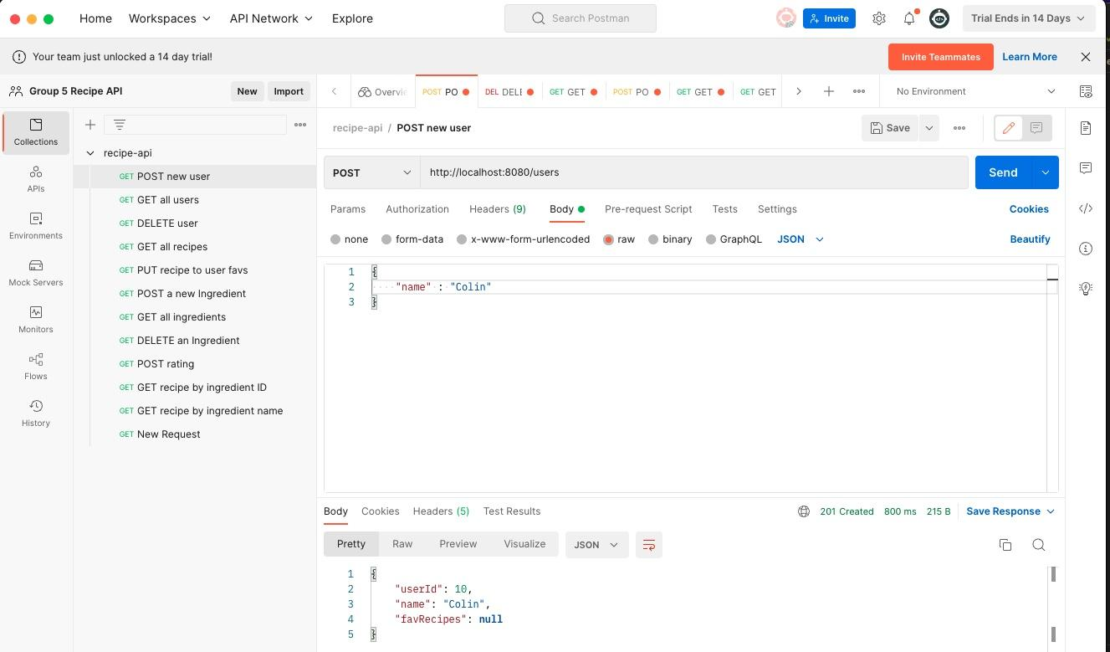
Demo
Notes:
Danielle

Slide 10
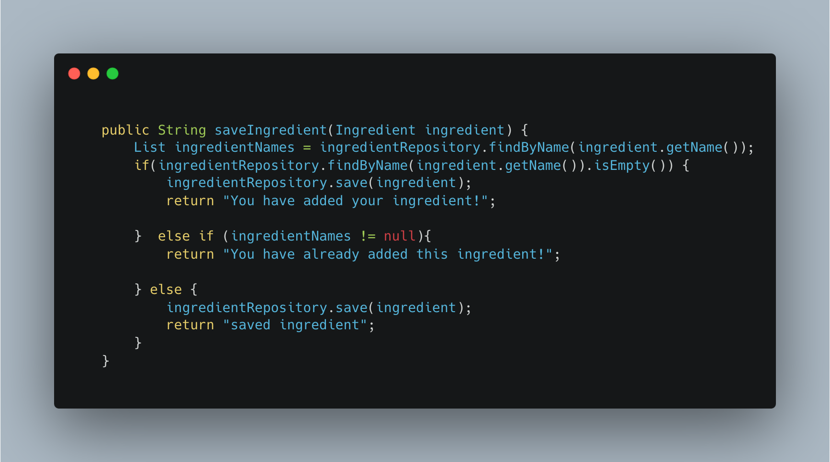
Ingredients : Ingredient Service
Adding ingredients to the API
This method does not allow ingredients to be added in duplicate!
Notes:
Danielle

Slide 11
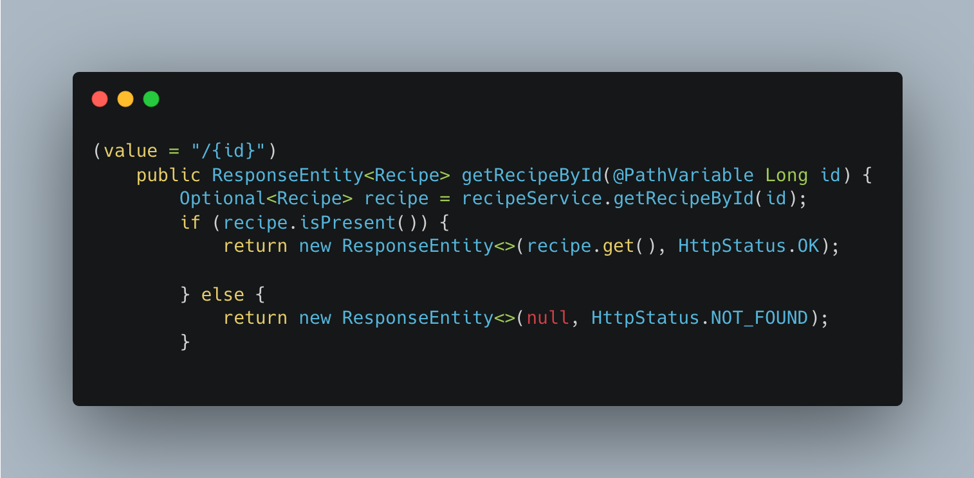
Recipe Controller - Request
GetMapping
Each recipe is given their own identifier + users can get recipes by typing in the Id.
If recipe id is not present
Notes:
Carla

Slide 12

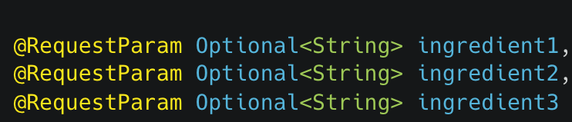

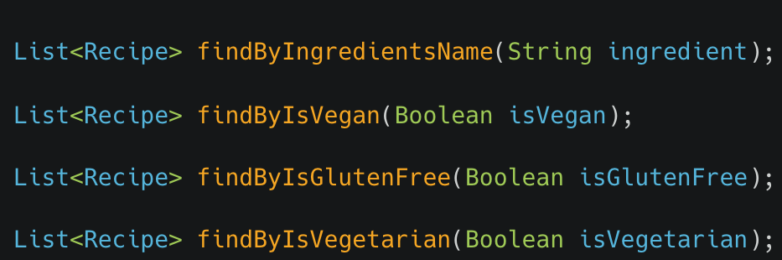

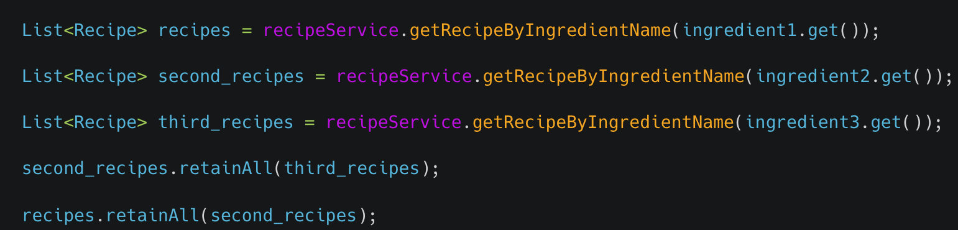

Recipe Controller
@GET
all recipes
@POST
new recipe
@GET
recipe by ingredients
@GET
recipe by dietary req
Notes:
Sakusan

Slide 13






Challenges & Improvements
Authentication
1
TDD
Add authentication so only user with the correct username and password can access account
Use TDD whilst writing logic to eliminate need for exhaustive Postman testing
6
2
Diet Plan
Custom Queries
Let user specify if they aim to gain or lose weight and return tailored recipes
Implement custom queries instead of combining same derived query
5
3
User favourites
Food groups
Utilise users list of favourite recipes to recommend similar recipe
Add food groups to ingredients to categorise and choose relevant recipes
4
Notes:
Sakusan
Remove specific recipe from user favorite list feature
Assigning food groups to ingredients: to be able to categorise and choose ingredients based on this
Getting recipes based on the number of ingredients available/missing
Test driven development
Custom query instead of merging several lists
Add user authentication to ensure that only the customer with the correct username and password can access their account

Slide 14

Thank you for listening!
Do you have any questions?
Notes:
Sakusan

